Slide 1
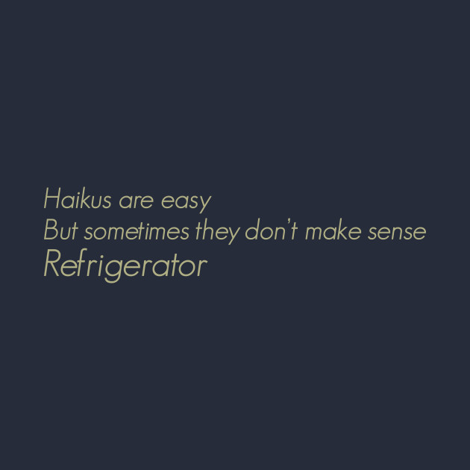
Lesson 4
Fixed form poetry
+ Nonsense poetry

Slide 2
Exercise
Make pairs/small groups to work together
Find out what the following forms of poetry entail en find examples.
Share your information with your group.
Haiku – Tanka – Cinquains – Limerick - Kennings

Slide 3
Haiku – 3 lines, 5 – 7- 5 syllables
Tanka – 5 lines, 5 -7 -5 -7 -7 syllables
Cinquains – 5 lines, 2 -4 -6 -8 -2 syllables
Limerick – 5 lines, AABBA rhyme.
Kennings – list of 2-word-lines to describe something.

Slide 4
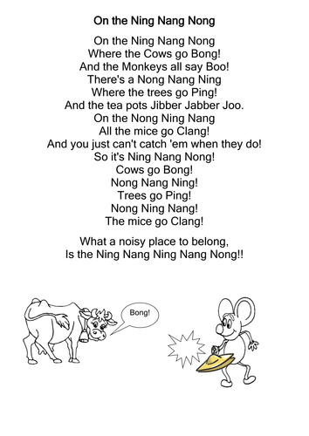

Slide 5
Nonsense poetry
Nonsense verse is a form of nonsense literature usually employing strong prosodic elements like rhythm and rhyme. It is whimsical and humorous in tone and employs some of the techniques of nonsense literature.
There are multiple ways of making nonsense poetry

Slide 6
Grammatical but not semantical
'I see' said the blind man to his deaf and dumb daughter
as he picked up his hammer and saw.

Slide 7
Nonsense words – words without a meaning
The Mungle pilgriffs far awoy
Religeorge too thee worled.
Sam fells on the waysock-side
And somforbe on a gurled,
With all her faulty bagnose!

Slide 8
contradictory or impossible scenarios
One tall midget reached up high,
Touched the ground above the sky,
Tied his loafers, licked his tongue,
And told about the bee he stung.
He painted, then, an oval square
The color of the bald man's hair,
And in the painting you could hear
What's undetected by the ear.

Slide 9
There was an old woman
This nonsense poem was specifically written
to be read out loud.
Strong rhythm

Slide 10
Exercise:
Work together with your group to write a poem in each category:
Haiku
Tanka
Cinquains
Limerick
Kennings
Nonsense poetry
There once was a maid from Madras
Who had her a pretty young ass
Not pretty and pink
As though you might think
But was grey, had long ears, and ate grass

